Slide 1
Booking a service through the Services Template
While logged in
Click to continue presentation

Slide 2


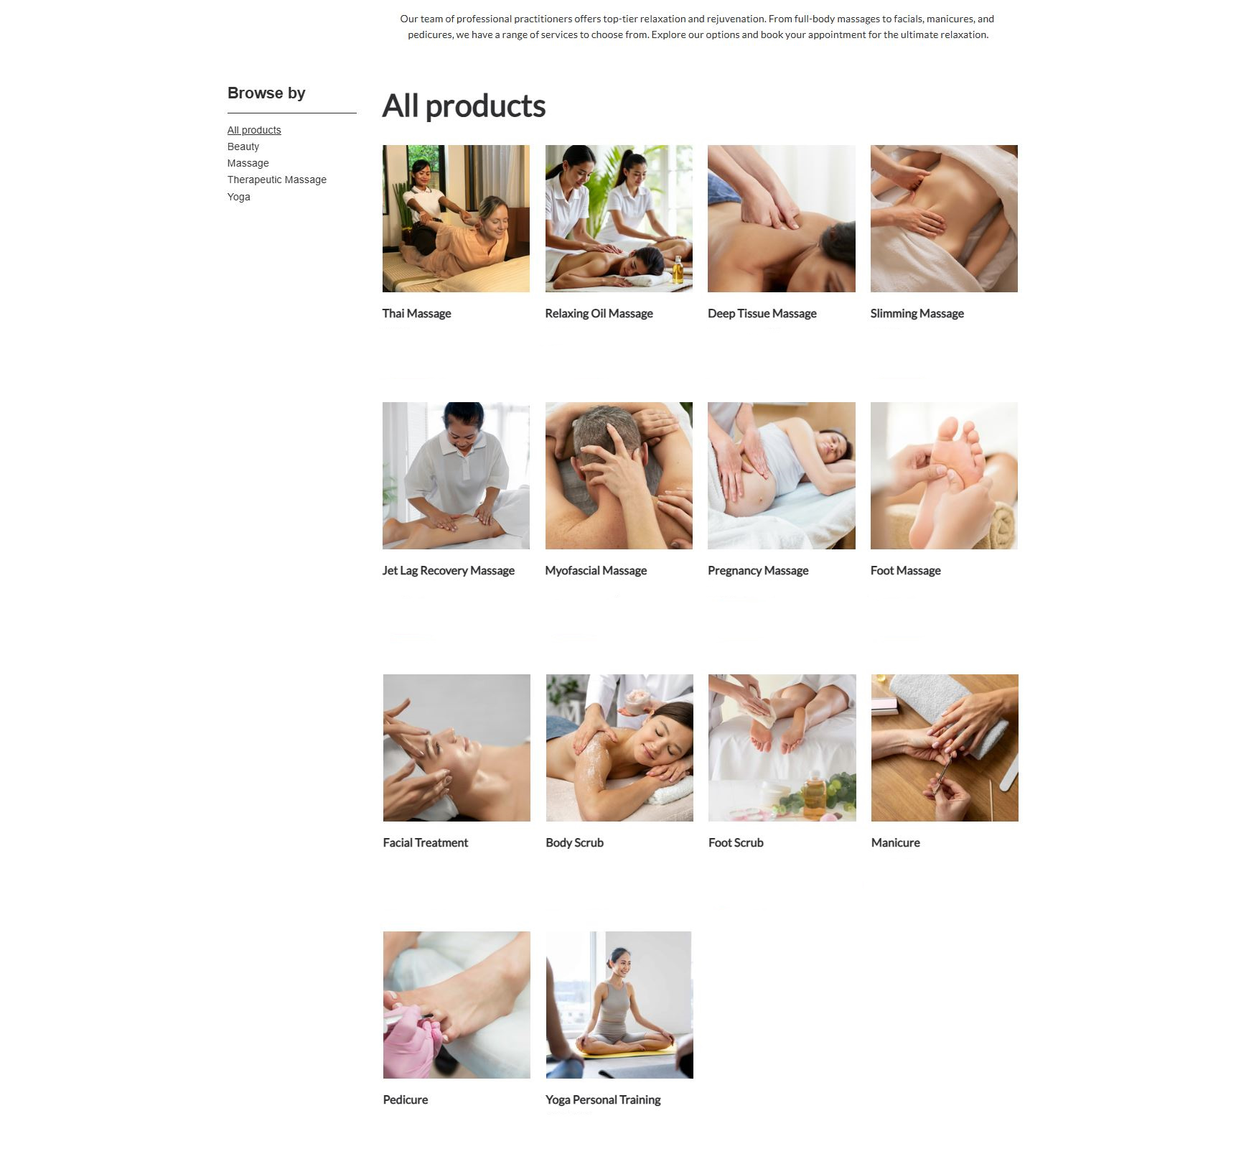

Home
Bookings
Services
About us
Contacts
Profile
Sign out
Germany Mobile Spa
From 25€ From 25€ From 35€ From 50€
Book
Book
Book
Book
From 45€ From 35€ From 25€ From 25€
Book
Book
Book
Book

Slide 3
Home
Bookings
Services
About us
Contacts
Profile
Sign out
Germany Mobile Spa
From 25€ From 25€ From 35€ From 50€
Book
Book
Book
Book
From 45€ From 35€ From 25€ From 25€
Book
Book
Book
Book
From 50€ From 35€ From 30€ From 25€
Book
Book
Book
Book
From 25€ From 50€
Book
Book

Slide 4
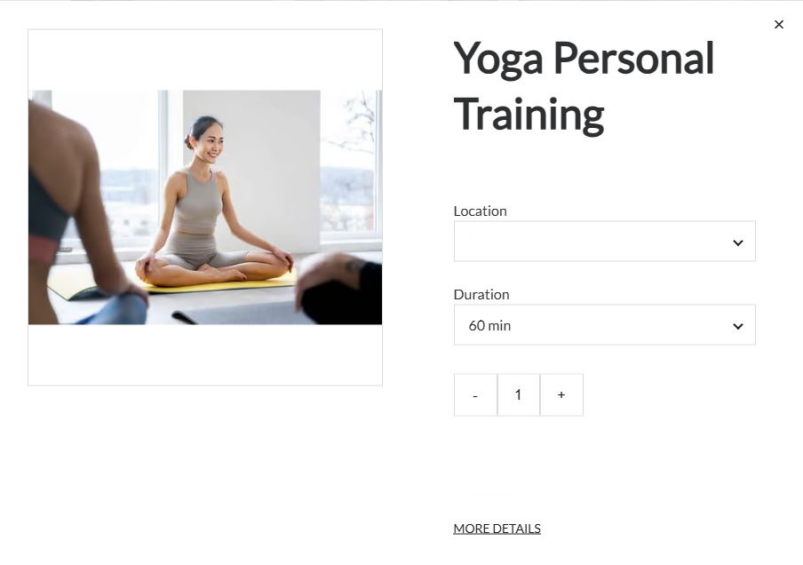
Home
Bookings
Services
About us
Contacts
Profile
Sign out
Germany Mobile Spa
Deep Tissue Massage
50.00€
From 50€ From 35€ From 30€ From 25€
Unter den Linden 12, 10117 Berlin
Book
Book
Book
Book
From 25€ From 25€ From 35€ From 50€
Book
Book
Book
Book
- +
Attendants
4
Preferred Therapist
Single
Male
Couple
Next
Female
Groups
No preference
From 25€ From 50€
Book
Book
From 45€ From 35€ From 25€ From 25€
Book
Book
Book
Book
From 50€ From 35€ From 30€ From 25€
Book
Book
Book
Book
From 25€ From 50€
Book
Book

Slide 5
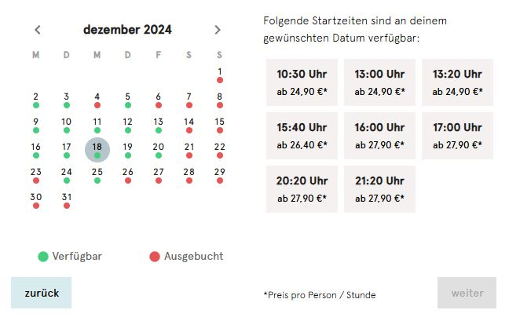
Home
Bookings
Services
About us
Contacts
Profile
Sign out
Germany Mobile Spa
December
50.00€
8:00 am
2:00 pm
8:00 pm
Unter den Linden 12, 10117 Berlin
10:00 am
4:00 pm
10:00 pm
Book
Book
Book
Book
From 25€ From 25€ From 35€ From 50€
12:00 am
6:00 pm
Book
Book
Book
Book
Attendants
4
Available
Booked out
Back
Single
Pay
Couple
Groups
From 45€ From 35€ From 25€ From 25€
Book
Book
Book
Book
From 50€ From 35€ From 30€ From 25€
Book
Book
Book
Book
From 25€ From 50€
Book
Book

Slide 6
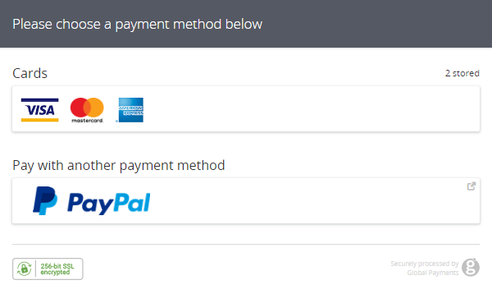
Home
Bookings
Services
About us
Contacts
Profile
Sign out
Germany Mobile Spa
From 25€ From 25€ From 35€ From 50€
Book
Book
Book
Book
From 45€ From 35€ From 25€ From 25€
Book
Book
Book
Book
From 50€ From 35€ From 30€ From 25€
Book
Book
Book
Book
From 25€ From 50€
Book
Book

Slide 7

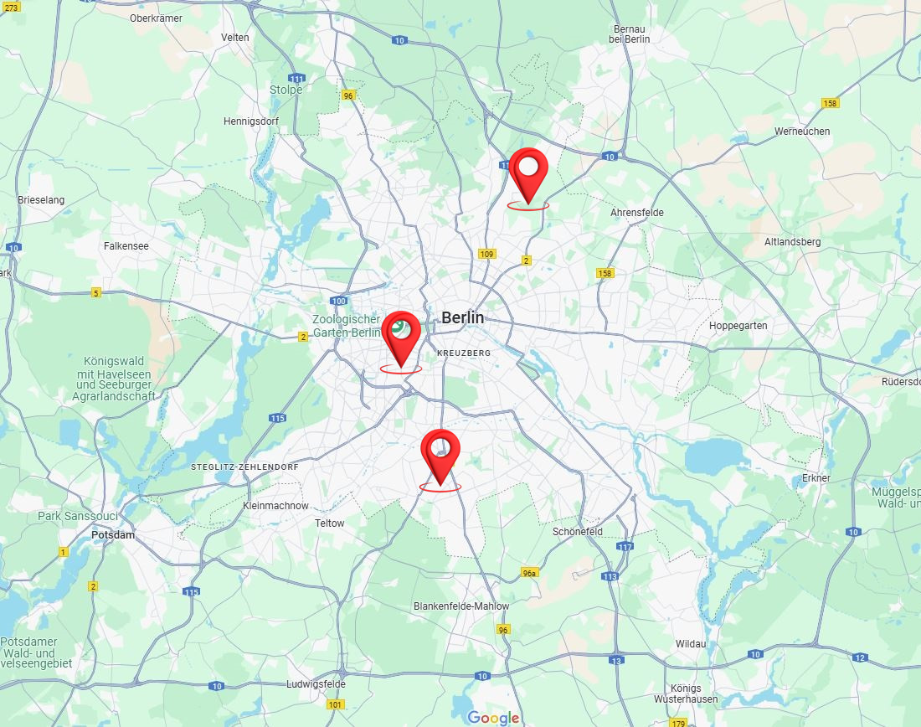





Home
Bookings
Services
About us
Contacts
Profile
Sign out
Germany Mobile Spa
Active Bookings
Winiger Strasse, Berlin 10000
Search for therapist
Date: 11.10.2024 Location: Winiger Strasse, Berlin 10000 bla bla Therapist: Casandra Sternritter, Thai Massagist Service: Thai Massage – 60 minutes Price: €80
Your therapist is on their way
__________________________________ History
Date: 11.10.2024 Location: Winiger Strasse, Berlin 10000 bla bla Therapist: Casandra Sternritter, Thai Massagist Service: Thai Massage – 60 minutes Price: €80
Use address
Request Therapist
- - - - - - - - - - - - - - - - - - - - - - - - - Date: 21.03.2023 Location: Winiger Strasse, Berlin 10000 bla bla Therapist: Casandra Sternritter, Thai Massagist
Use address
Request Therapist

